Slide 1
ECG Heart Monitor
Fadi adel Dawoud
https://github.com/theRadFad/HeartMonitor

Slide 2
Problem definition
Electrocardiogram (ECG) monitors are analog sensors that produce an analog electrical signal corresponding to electric signals generated through a patient’s heartbeat.
Biological signals are recorded through special electrodes and are passed to a signal conditioning circuit to amplify and enhance the signals for further analysis.
For this project, the signal conditioning circuit is within the AD8232 component.

Slide 3
Hardware used
UART
Serial communication between microcontroller and the PC
ADC
Converting analog ECG readings to digital values
General purpose timers
Timer 1 to regulate readings according to the sampling frequency
Timer 2 to compute 60 seconds of data
Timer 3 to regulate readings of 100 samples/s for bpm calculation
ECG Circuit Conditioning (AD8232)
Cleaning and amplifying bio-signals for further analysis and displaying

Slide 4
Software used
Tkinter GUI Library for Python
pySerial library for serial sending/receiving
STM32CubeMX
KEIL uVision5

Slide 5
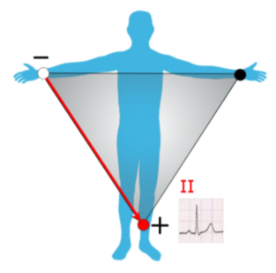
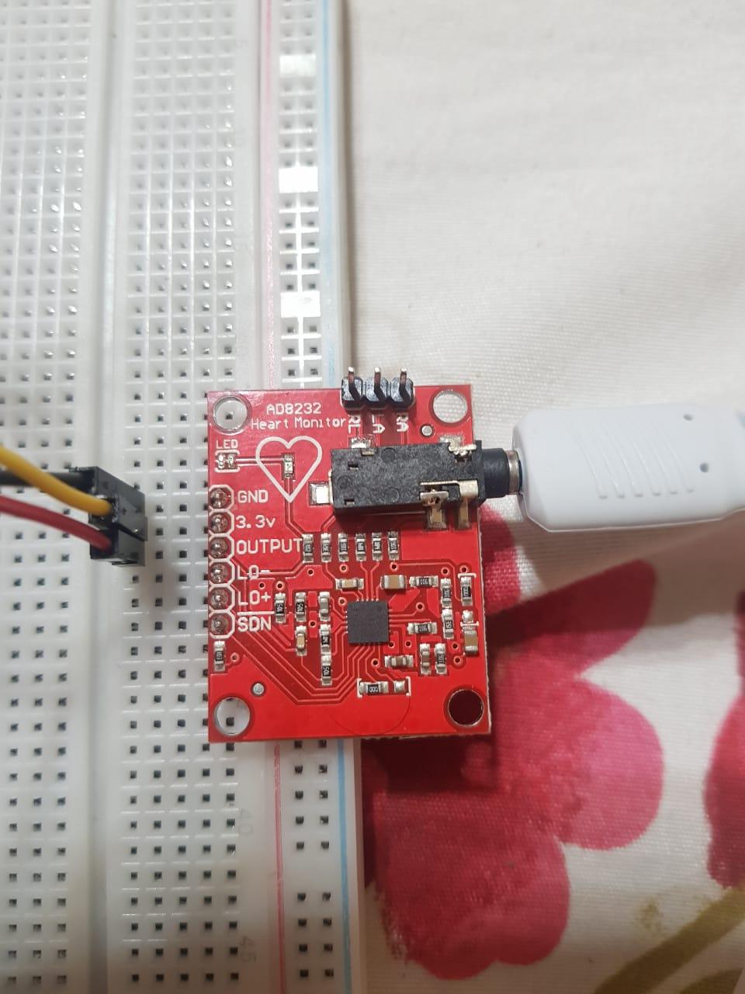
Circuit conditioning
AD8232 is used
It takes as input 3-electrodes placed at specific parts of the patient’s body

Slide 6
Architecture Diagram

Slide 7
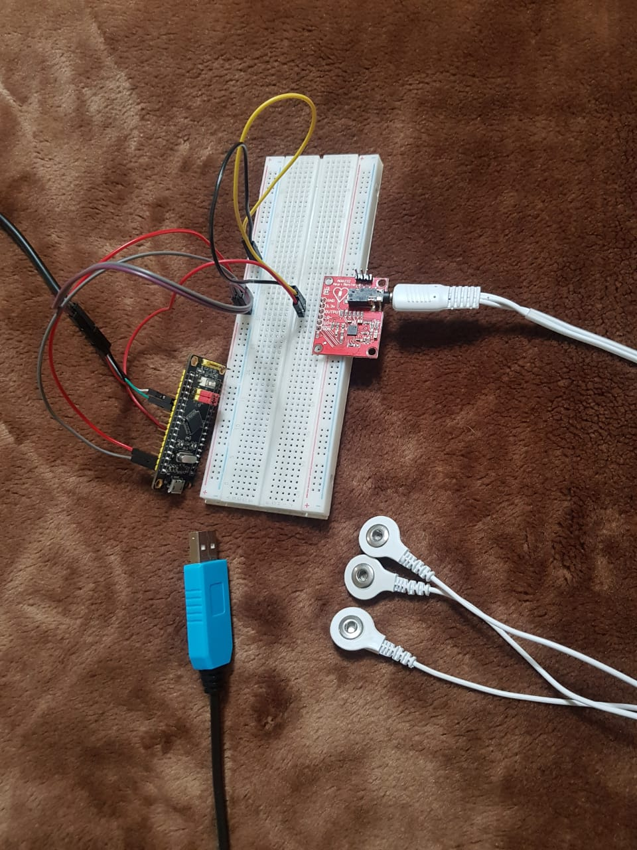
The physical circuit

Slide 8
Supported MCU Commands
“a”
Returns an integer representing the heart rate (after three seconds)
“b”
Immediately starts returning ADC readings at the specified sampling rate for 60 seconds
“c<rate>c” (example: “c50c”)
Sets the ADC sampling rate to “rate” (in the example it becomes 50)

Slide 9
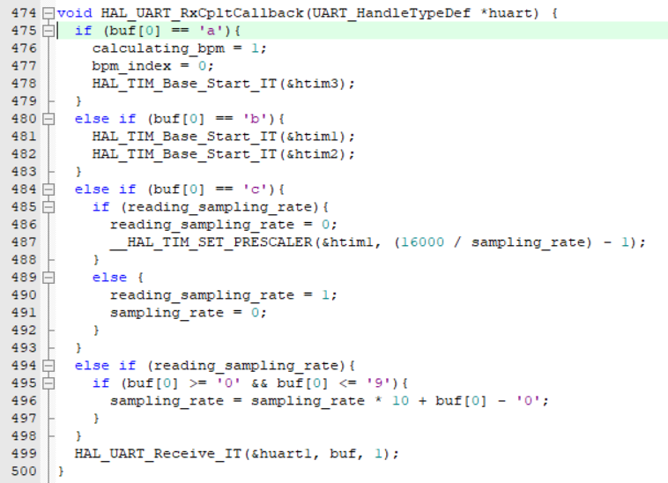
UART Interrupt handler (acknowledging the commands)

Slide 10
Setting sampling rate
Serial command example: “c50c”
Modifies Timer 1 in the microcontroller
Timer 1 has a fixed counter period of 500 and clock frequency of 8 MHz
Timer 1 pre-scaler is modified with the sampling rate
Pre-scaler = 16000 / sampling rate
Overflow frequency = 8000000 / ( 500 * 16000 / sampling rate ) = sampling rate
Overflow interrupt handler is called with the same frequency as the specified sampling rate
The handler initiates ADC conversion of the input ECG signal

Slide 11
Reporting 60 seconds of data (Mcu side)
Serial command: “b”
The command enables Timer 1 and Timer 2
Timer 1 enables ADC conversion at the specified sampling rate, reporting the output over UART
Timer 2 has an overflow period of 60 seconds and disables Timer 1 (and itself) on first overflow
Timer 2 has a pre-scaler value of 16000 and counter period of 30000 and clock frequency of 8 MHz
Timer 2 period = 16000 * 30000 / 8000000 = 60 seconds

Slide 12
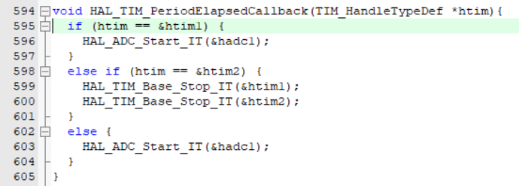
Timer interrupt callbacks

Slide 13
Calculating heart rate
Serial command “a”
Enables Timer 3 which has an overflow period of 10 ms to collect ADC data for 3 seconds
Timer 3 has a pre-scaler value of 800 and a counter period of 100
Period = 800 * 100 / 8000000 = 0.01 s = 10 ms
200 data points are collected
Collected data points are analyzed to determine the heart rate

Slide 14
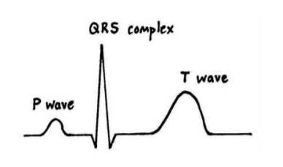
Heart rate algorithm (tentative)
The first peak is identified in the 2 seconds window
A peak is defined as a data point with a larger value than the 60 surrounding points
The next peak is identified in the same way
The period of the heart rate is the time difference of the two peaks
Heart rate in BPM = 60 / period (in seconds)

Slide 15
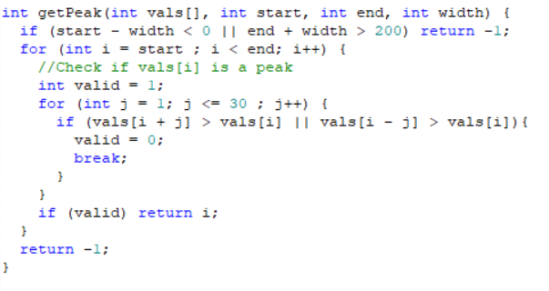

Heart rate Algorithm implementation

Slide 16
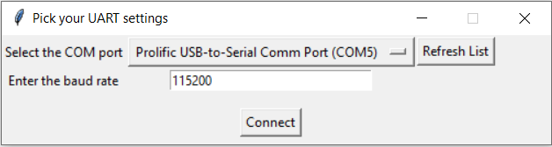
PC Side
PC application running on top of Python and Tkinter for GUI
Connected to the microcontroller via serial connection
pySerial on the PC side
UART module on the MCU side
GUI allows user to select the COM port and the baud rate to connect with the microcontroller

Slide 17
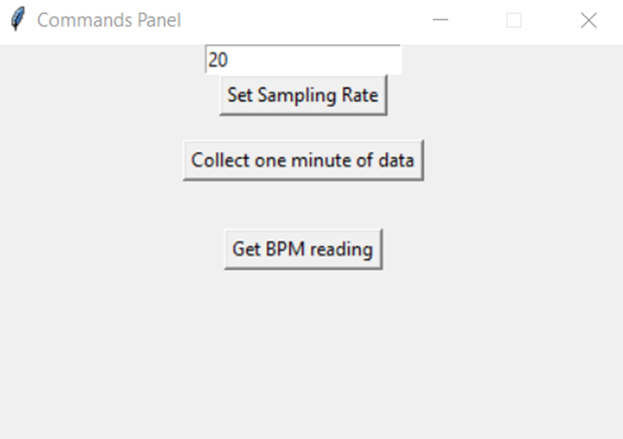
COMMANDS GUI
Three commands are available to users
Setting sampling rate. Must enter a valid positive integer
Displaying one minute worth of data (check next slide for details)
Calculating the heart rate in BPM (jump two slides forward)

Slide 18
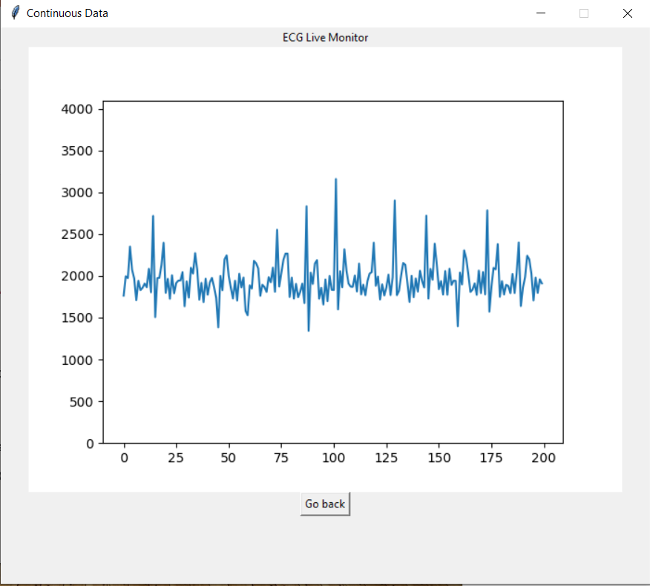
Displaying ECG Data in real time
Choosing to display continuous ECG data, the app issues a serial command to the MCU (“b”)
The MCU returns continuous readings for 60 seconds at the specified sampling rate
The app displays a screen that is updated in real time of the ECG data

Slide 19
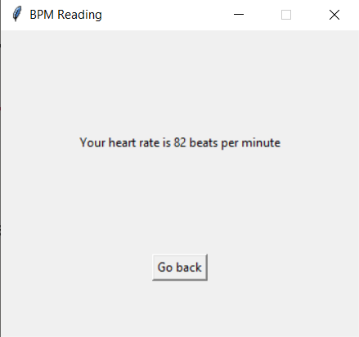
Calculating heart rate
The PC app issues a serial command to the MCU “a”
The MCU performs the algorithm outlined in slide 11
The value is displayed to the user

